Slide 1
Welcome

Slide 2
DOUBLE STORIED 3D HOUSE

Slide 3
Team Members
Team
Md. Nur A Neouse
ID: 193002093
Nazifa Alam Nowrin
ID: 193002103
Study Nests
Jakirul Islam
ID:193002101

Slide 4
Introduction of Topic
Motivation
Abstract
Contents
Tools
Measurements
Steps

Slide 5
Motivation
The topic we chose was Architectural. Our group chose this topic because we thought it would benefit us most.

Slide 6
Abstract
3D

Slide 7
Drawing Tools
Extrude
Sweep
Union
Subtract
Intersect
Limit
Offset
3d polyline
Move
Pedit
presspull

Slide 8
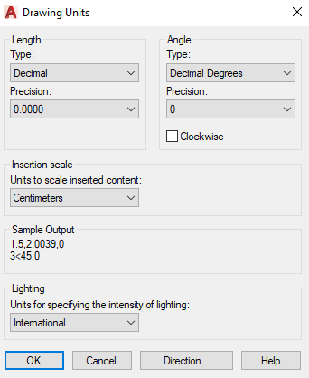
Measurements
Software:
1. AutoCAD 2022 version
Units:
1. length type : decimal
2.precision :(0’-0’’).
3.insertion scale :cm
4.Intensity of lighting : International

Slide 9
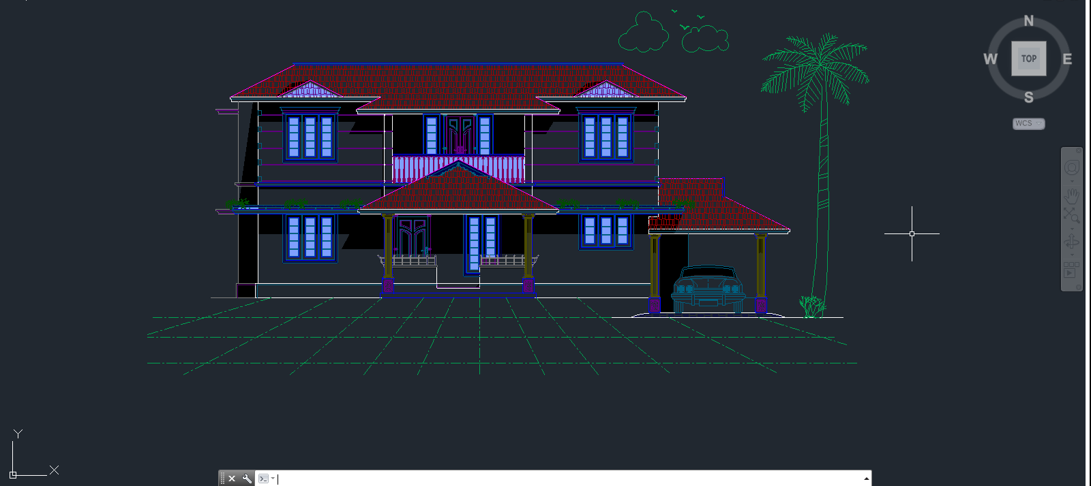
Steps
DOUBLE STORIED 3D HOUSE

Slide 10
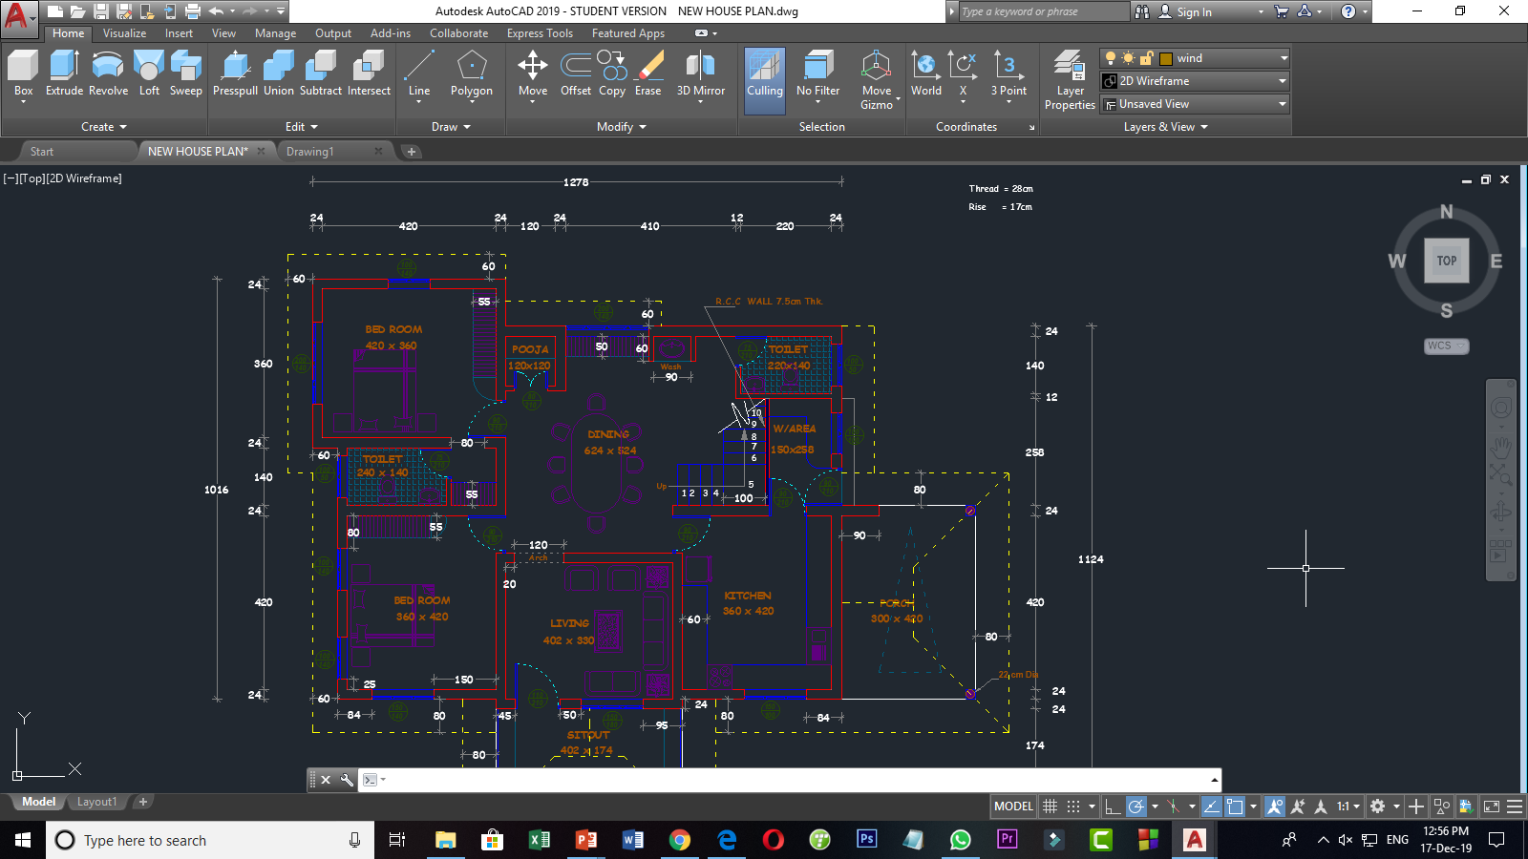
Step 1: (Proper Planning)

Slide 11
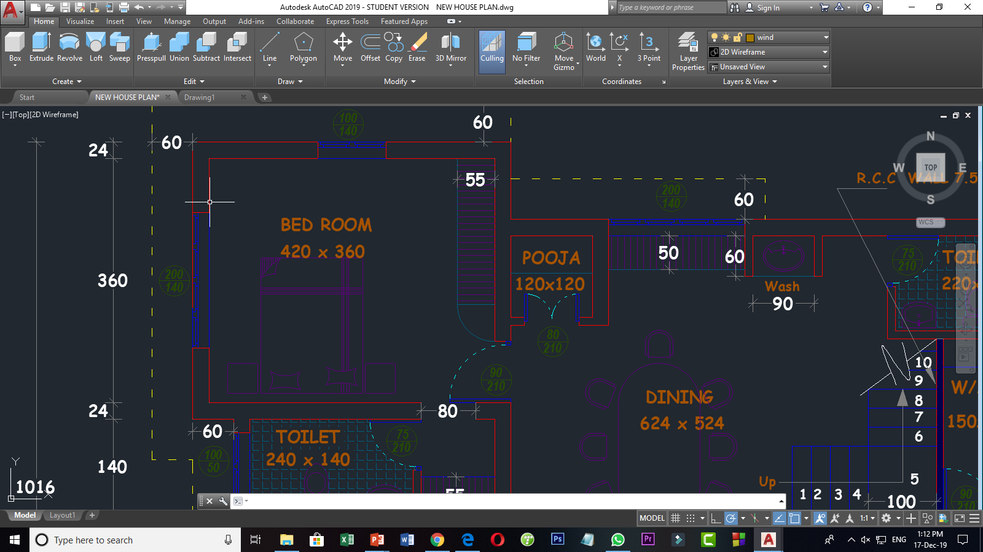
Step 2: Bed Room

Slide 12
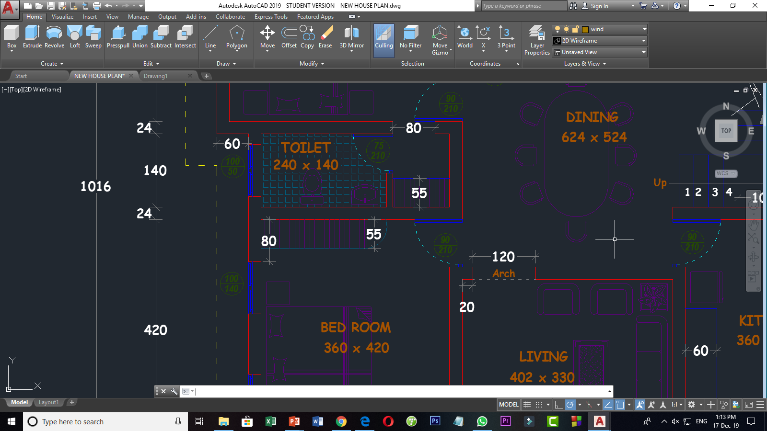
Step 3: Living Room, Toilet, Dining

Slide 13
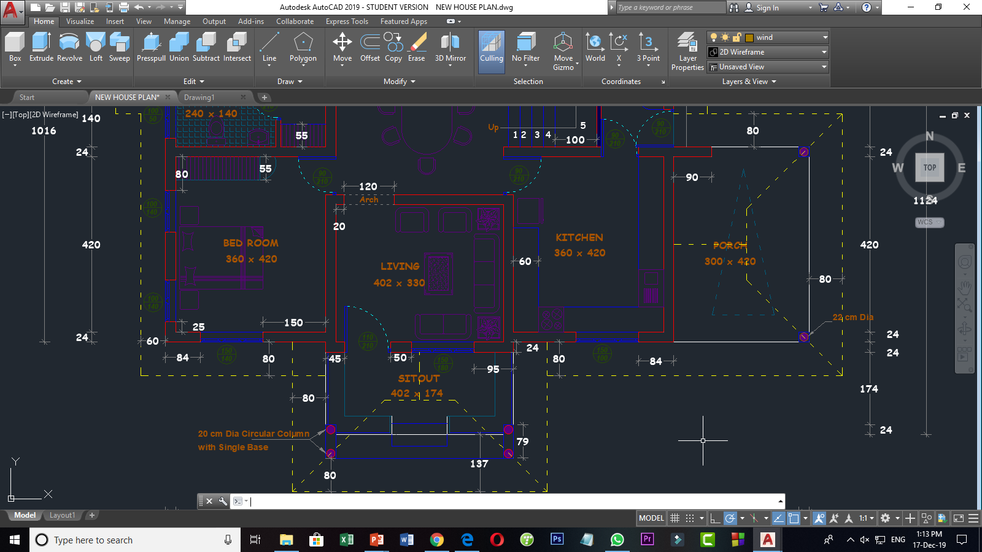
Step 4: Living Room, Kitchen, Porch & Sitout

Slide 14
Step 5: Ready for Convert 3D Mode

Slide 15
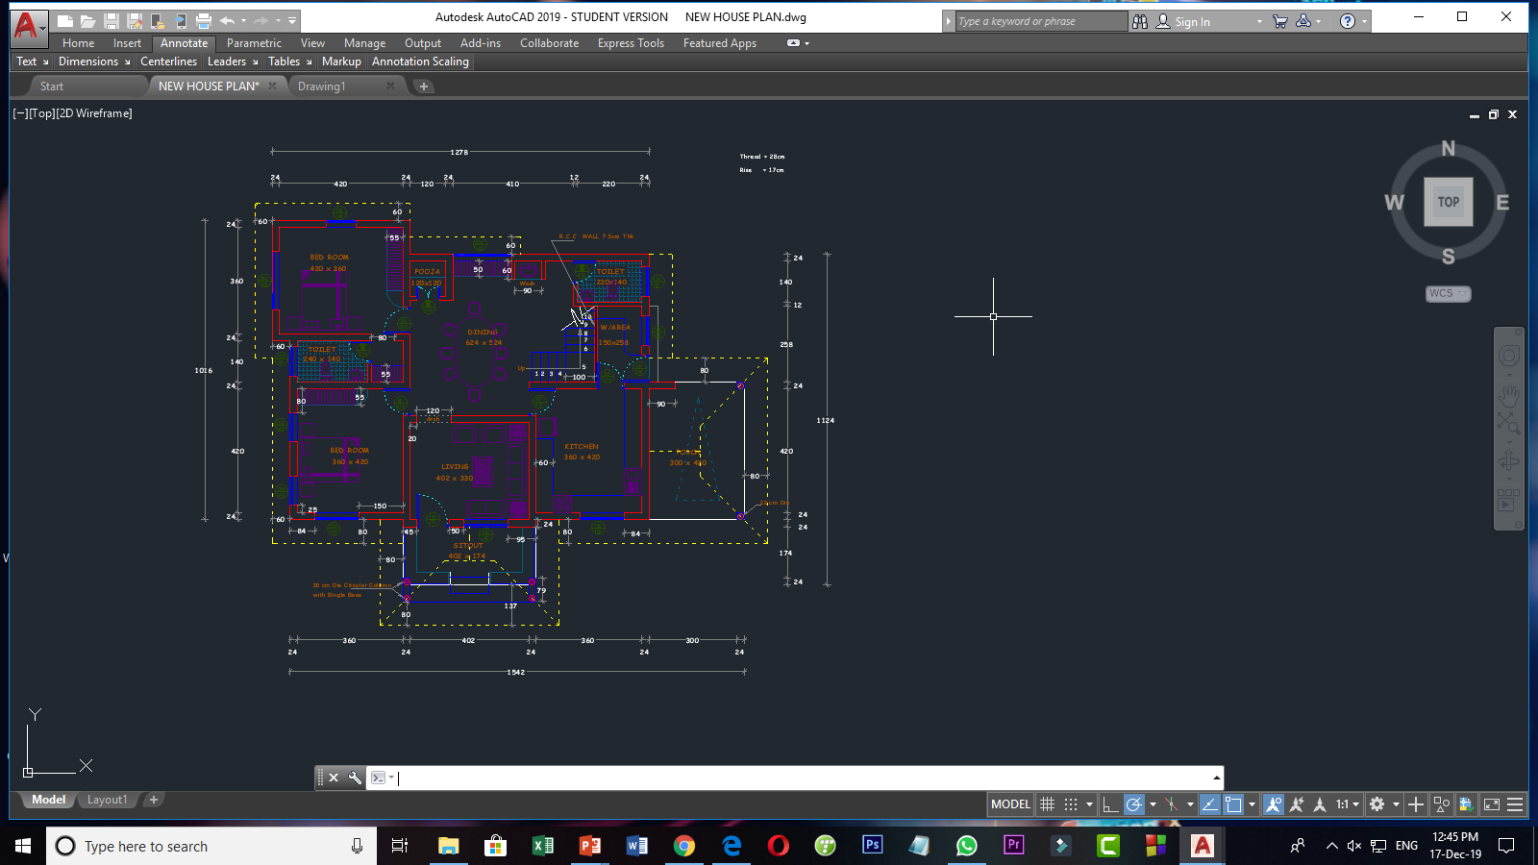
Step 6: Let’s Convert 3D Mode

Slide 16
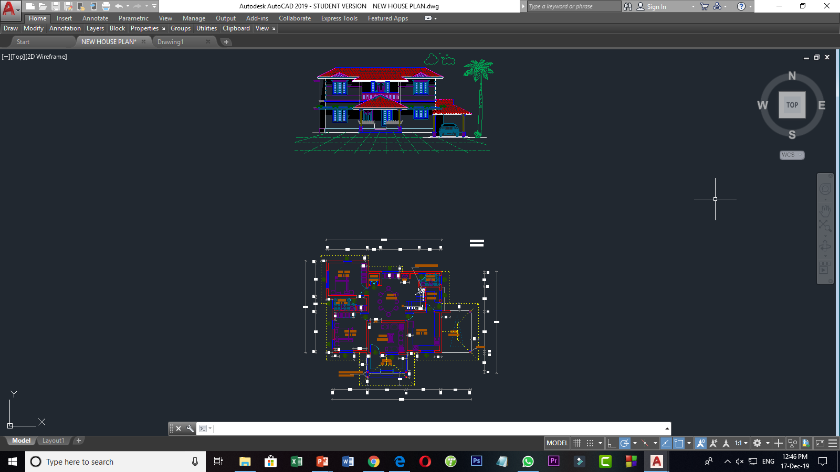
Step 7: 3D Mode

Slide 17
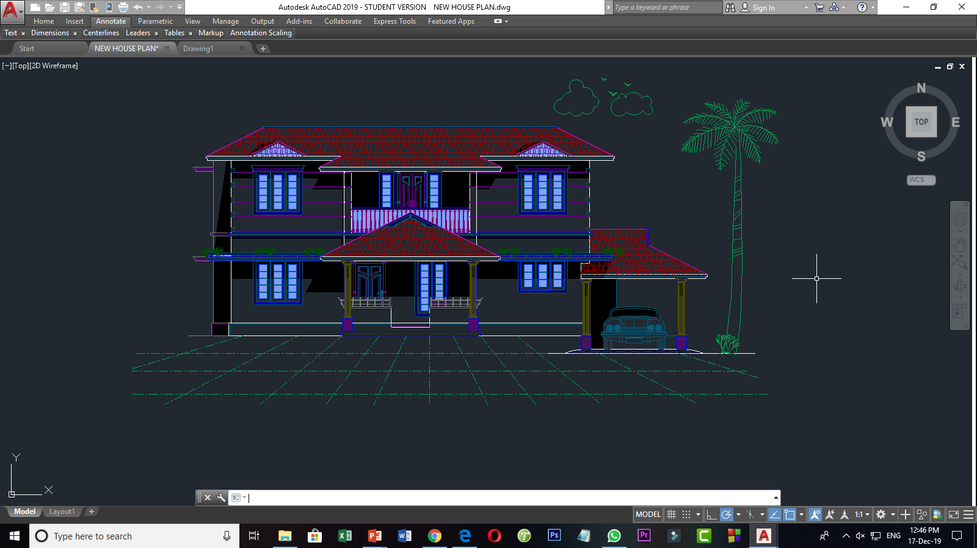
Step 8: Expected 3D House

Slide 18
Problems we faced
Had some slow issues because of my laptop
Had some issues with the presspull commend, it was slowing down
The application stopped once

Slide 19



Reference
https://www.youtube.com/watch?v=zgj-0wyfAmE
https://youtu.be/5KzWACtyocs

Slide 20


Slide 21
